Slide 1
Intrusion Detection Systems (IDS)

Slide 2
Intrusion and Intrusion Detection
An intrusion is a deliberate, unauthorized attempt to access or manipulate information or system and to render them unreliable or unusable.
Intruders may be from outside the network or legitimate users of the network.
When suspicious activity is from your internal network it can also be classified as misuse

Slide 3
Intrusion Detection Systems (IDS)
Intrusion Detection Systems look for attack signatures, which are specific patterns that usually indicate malicious or suspicious intent.

Slide 4
Frequency vs Difficulty level
The frequency of probes, attacks, or intrusions attempts is inversely proportional to the difficulty level required to perform such attacks.
A clear trend has been identified over the past recent years. Graphical tools that are getting very sophisticated have replaced the combersome command line utilities.
They are now available for Windows as well as other platforms.
It is no longer necessary to have any computer knowledge to break through defense mechanisms that are not properly maintained.

Slide 5
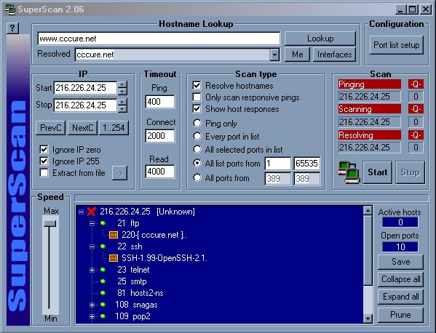
HACKING TOOLS
(EASY TO GET, EASY TO USE, VERY POWERFULL)

Slide 6
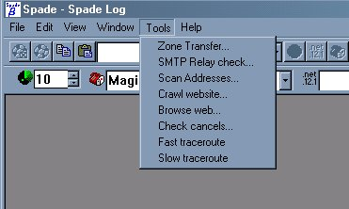
My friend SAM SPADE

Slide 7
WHY DO I NEED AN IDS, I HAVE A FIREWALL?
IDS are a dedicated assistant used to monitor the rest of the security infrastructure
Today’s security infrastructure are becoming extremely complex, it includes firewalls, identification and authentication systems, access control product, virtual private networks, encryption products, virus scanners, and more.
All of these tools performs functions essential to system security. Given their role they are also prime target and being managed by humans, as such they are prone to errors.
Failure of one of the above component of your security infrastructure jeopardized the system they are supposed to protect

Slide 8
WHY DO I NEED AN IDS, I HAVE A FIREWALL?
Not all traffic may go through a firewall
i:e modem on a user computer
Not all threats originates from outside. As networks uses more and more encryption, attackers will aim at the location where it is often stored unencrypted (Internal network)
Firewall does not protect appropriately against application level weakenesses and attacks
Firewalls are subject to attacks themselves
Protect against misconfiguration or fault in other security mechanisms

Slide 9
WHAT CAN IDS REALISTICLY DO
  Monitor and analyse user and system activities
  Auditing of system and configuration vulnerabilities
  Asses integrity of critical system and data files
  Recognition of pattern reflecting known attacks
  Statistical analysis for abnormal activities
  Data trail, tracing activities from point of entry up to the point of exit
  Installation of decoy servers (honey pots)
  Installation of vendor patches (some IDS)

Slide 10
WHAT IDS CANNOT DO
  Compensate for weak authentication and identification mechanisms
  Investigate attacks without human intervention
  Guess the content of your organization security policy
  Compensate for weakeness in networking protocols, for example: IP Spoofing
  Compensate for integrity or confidentiality of information
  Analyze all traffic on a very high speed network
  Deal adequately with attack at the packet level
  Deal adequately with modern network hardware

Slide 11
Intrusion Detection Systems (IDS)
Different ways of classifying an IDS
IDS based on
  anomaly detection
  signature based misuse
  host based
  network based

Slide 12
Anomaly based IDS
This IDS models the normal usage of the network as a noise characterization.
Anything distinct from the noise is assumed to be an intrusion activity.
  E.g flooding a host with lots of packet.
The primary strength is its ability to recognize novel attacks.

Slide 13
Anomaly Detection Systems (1)
Anomaly detection techniques assume that all intrusive activities are necessarily anomalous.
Statistical Approaches:
  initially, behavior profiles for subjects are generated. As the system continues running, the anomaly detector constantly generates the variance of the present profile from the original one.

Slide 14
Anomaly Detection Systems (2)
Predictive Pattern Generation:
  This method of intrusion detection tries to predict future events based on the events that have already occurred.
  The problem with this is that some intrusion scenarios that are not described by the rules will not be flagged intrusive.
Neural Networks:
  The idea here is to train the neural network to predict a user’s next action or command, given the window of n previous actions or commands.
  After the training period, the network tries to match actual commands with the actual user profile already present in the net.

Slide 15
Drawbacks of Anomaly detection IDS
Assumes that intrusions will be accompanied by manifestations that are sufficiently unusual so as to permit detection.
These generate many false alarms and hence compromise the effectiveness of the IDS.

Slide 16
Signature based IDS
This IDS possess an attacked description that can be matched to sensed attack manifestations.
The question of what information is relevant to an IDS depends upon what it is trying to detect.
  E.g DNS, FTP etc.

Slide 17
Signature based IDS (contd.)
ID system is programmed to interpret a certain series of packets, or a certain piece of data contained in those packets,as an attack. For example, an IDS that watches web servers might be programmed to look for the string “phf” as an indicator of a CGI program attack.
Most signature analysis systems are based off of simple pattern matching algorithms. In most cases, the IDS simply looks for a sub string within a stream of data carried by network packets. When it finds this sub string (for example, the ``phf'' in ``GET /cgi-bin/phf?''), it identifies those network packets as vehicles of an attack.

Slide 18
Drawbacks of Signature based IDS
They are unable to detect novel attacks.
Suffer from false alarms
Have to programmed again for every new pattern to be detected.

Slide 19
Host/Applications based IDS
The host operating system or the application logs in the audit information.
These audit information includes events like the use of identification and authentication mechanisms (logins etc.) , file opens and program executions, admin activities etc.
This audit is then analyzed to detect trails of intrusion.

Slide 20
Drawbacks of the host based IDS
The kind of information needed to be logged in is a matter of experience.
Unselective logging of messages may greatly increase the audit and analysis burdens.
Selective logging runs the risk that attack manifestations could be missed.

Slide 21
Strengths of the host based IDS
Attack verification
System specific activity
Monitoring key components
Near Real-Time detection and response.
No additional hardware

Slide 22
Stack based IDS
They are integrated closely with the TCP/IP stack, allowing packets to be watched as they traverse their way up the OSI layers.
This allows the IDS to pull the packets from the stack before the OS or the application have a chance to process the packets.

Slide 23
Network based IDS
This IDS looks for attack signatures in network traffic via a promiscuous interface.
A filter is usually applied to determine which traffic will be discarded or passed on to an attack recognition module. This helps to filter out known un-malicious traffic.

Slide 24
Strengths of Network based IDS
Packet analysis
Real time detection and response
Malicious intent detection
Operating system independence

Slide 25
Commercial ID Systems
ISS – Real Secure from Internet Security Systems:
  Real time IDS.
  Contains both host and network based IDS.
Tripwire – File integrity assessment tool.
Bro and Snort – open source public-domain system.

Slide 26
Performance Objectives for an IDS
Broad Detection Range:
For each intrusion in a broad range of known intrusions the IDS should be able to distinguish the intrusion from normal behavior.
Economy in Resource Usage:
The IDS should function without using too much system resources such as main memory, CPU time, and disk space.
Resilience to Stress:
The IDS should still function correctly under stressful conditions in the system such as a very high level of computing activity.

Slide 27
Testing Methodology
The test procedures are divided into three categories:
  Intrusion Identification Tests
  The Intrusion Identification Tests measure the ability of the IDS to distinguish known intrusions from normal behavior.
  Resource Usage Tests
  The Resource Usage Tests measure how much system resources are used by the IDS The results of these tests can be used for example to decide if it is practical to run a particular IDS in a particular computing environment.
  Stress Tests
    Smokescreen Noise.
    High-volume sessions.
    Intensity.

Slide 28
What is a honeypot?
a honeypot is a system designed to teach how intruders probe for and exploit a system. By learning their tools and methods, you can then better protect your network and systems.
Honeypots are decoy/trap systems that are designed to attract a potential attacker away from critical systems.

Slide 29
Honeypots are Designed To
Divert an attacker from accessing critical systems.
Collect information about the attacker’s activity.
Encourage the attacker to stay on the system long enough for administrators to respond.

Slide 30
Building a Honeypot
There are a variety of different approaches to building a honeypot:
  You can just as easily use any other operating system. Don't do anything special to this system, build it as you would any other. Then put the system on the Internet and wait.
  Emulate variety of different systems. A commercial product called “CyberCopSting” Designed to run on NT, this product can emulate variety of different systems at the same time

Slide 31
The plan
The simple plan is to build a box I wanted to learn about, put it on the network, and then wait.
  How do I track the intruders moves?
  How do I alert myself when the system is probed or compromised?
  how do I stop the intruder from compromising other systems?
The solution to this was simple, put the honeypot on its own network behind a firewall.

Slide 32
Tracking Their Moves (1)
Do not want to depend on a single source of information, track in layers.
Do not log information on the honeypot itself.
  The fewer modification you make to the honeypot, the better. The more changes you make, the better the chance a black-hat will discover something is up.
  You can easily lose the information.

Slide 33
Tracking Their Moves (2)
first layer of tracking is the firewall logs.
A second layer is the system logs!!!
third layer of tracking is to use a sniffer.
  The advantage of a sniffer is it picks up all keystrokes and screen captures.
run tripwire on the honeypot.
  what binaries have been altered on a compromised system

Slide 34
The Sting
We want to attract the intruders, monitor them, let them gain root, and then eventually put them off the system, all without them getting suspicious.
  Rebooting the machine.
To attract intruders, you can name honeypot enticing names:
  “ns1.example.com” (name server).
  “mail.example.com” (mail server).
  “intranet.example.com” (internal web server).

Slide 35
A Virtual Honeypot Framework (Honeyd)
A framework for virtual honeypots that simulates virtual computer systems at the network level.
The simulated computer systems appear to run on unallocated network addresses.
Honeyd simulates the networking stack of different operating systems and can provide arbitrary routing topologies and services for an arbitrary number of virtual systems.
Honeyd is freely available as source code and can be downloaded from http://www.citi.umich.edu/u/provos/honeyd/.

